Slide 1
Kirchhoff’s Current Law

Slide 2

By the end of this lesson, you will be able to:
Describe Kirchhoff’s current law.
Calculate the current in one branch of a circuit using Kirchhoff’s current law.

Slide 3
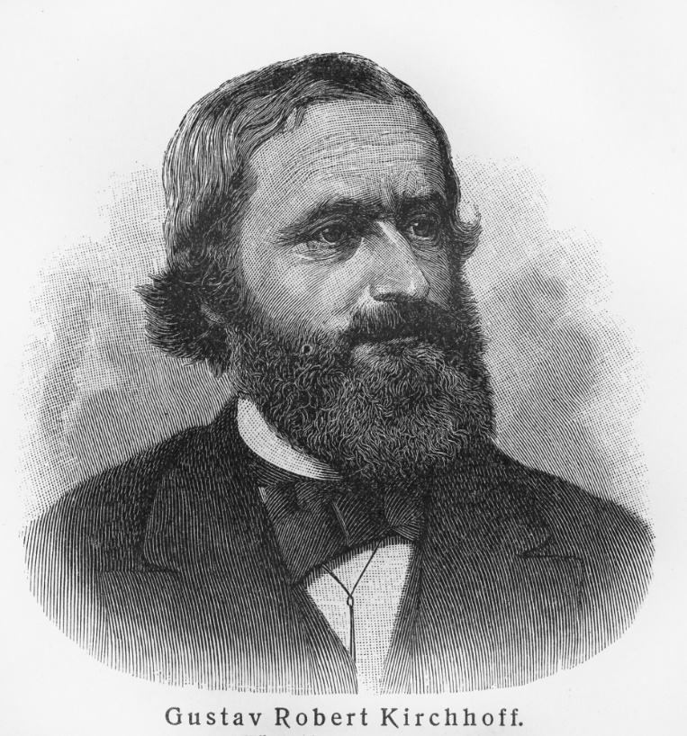
Introduction to Kirchhoff's Current Law
Gustav Kirchhoff was a German physicist who dedicated his life to research in spectroscopy, radiation, thermochemistry and electrical circuits. In 1845, he invented Kirchhoff’s current law to formally describe how current behaves at a junction.
Applying this law, we can understand the movement of current in more complex circuits, and can utilise this to calculate unknown currents.

Slide 4

At a junction, current is divided between parallel branches.
When current reaches a junction in a circuit, the full amount cannot continue down each of the following branches. Instead, that current must get divided and shared between the branches.

Slide 5
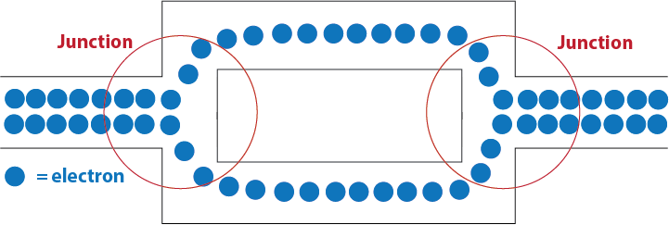
Kirchhoff’s Current Law states that current going into a junction must be the same as the current going out.
We know that current is not lost in a circuit; it cannot jump out of the wires and be lost to the air! Therefore, the amount of current entering a junction must be the same as the sum of currents exiting the junction.
This is Kirchhoff’s Current Law: All current that goes into a junction must be equal to the current coming back out.
At a circuit junction, the electrons making up the current are divided between parallel branches. The amount of electrons coming into the junction is equal to the sum of electrons in the parallel branches.

Slide 6


So how can we express this mathematically?
Where I is the current in different parts of a circuit, and n is the number of branches at the junction.
This is sometimes written as ΣI_{in}​=ΣI_{out​}, which also means the sum of currents coming into the junction is equal to the sum of currents coming out of the junction.

Slide 7
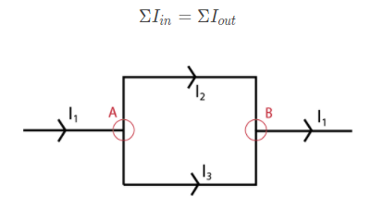
Let’s look at Kirchhoff’s current law equation in terms of this section of a circuit diagram.
Starting with Junction A, I₁​ is the current coming into the junction. I_{2​} and I₃ ​are the currents of the two branches coming out of the junction. Kirchhoff’s current law states that the current coming into a junction is equal to the sum of currents coming out. Therefore, for this junction we can write this mathematically as I₁​=I₂​+I₃​.
Looking at Junction B, this time I₂​ and I₃​ are the currents coming into the junction, and I₁​ is the current coming back out. Therefore, can write this mathematically as I₂​+I₃​=I₁​.
From this, we can also see that the equations for both Junction A and Junction B are the same! Regardless of how the current is divided between these branches, when the branches merge back together, the original current (I1​) will be recreated!

Slide 8
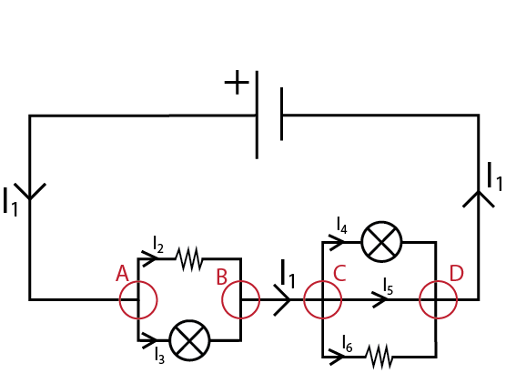
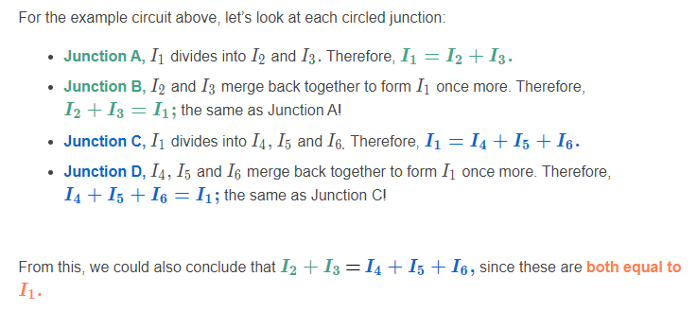
Sometimes there is more than one point in a circuit at which the current must branch and be divided.
These circuits can be approached just as simply by applying Kirchhoff’s current law at each individual junction.

Slide 9
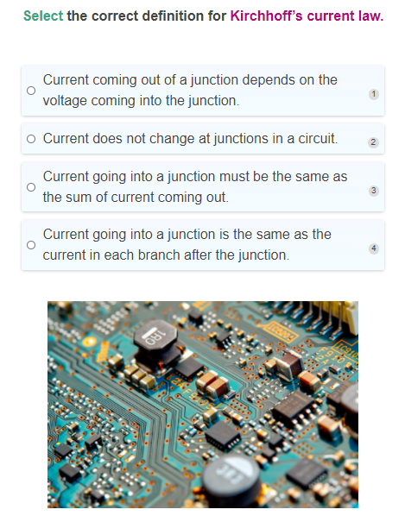

Slide 10
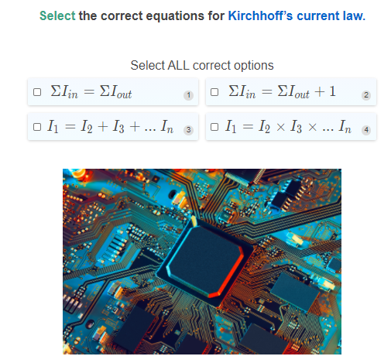

Slide 11
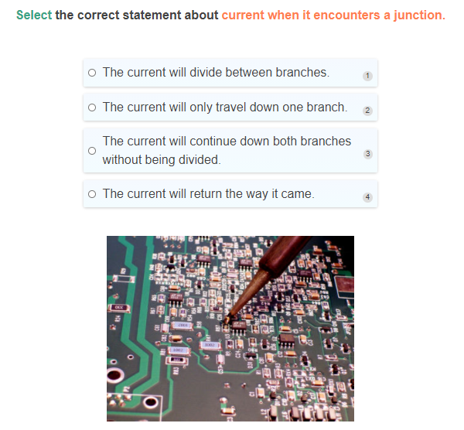

Slide 12
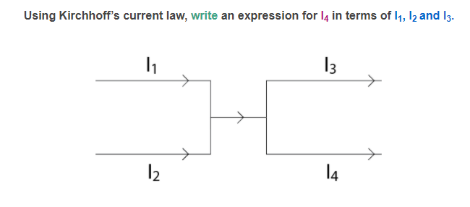

Slide 13

Sometimes circuits have multiple batteries.
Each battery acts as a different source for current to emerge from, and return to. This can result in alternative directions of current flow. At every individual junction, however, Kirchhoff’s current law still holds true.
It is also important to note that the amount of current that leaves a battery is the same amount that will return to that battery after travelling around the circuit. This will be covered in greater detail in an upcoming lesson on Kirchhoff’s Voltage Law.

Slide 14
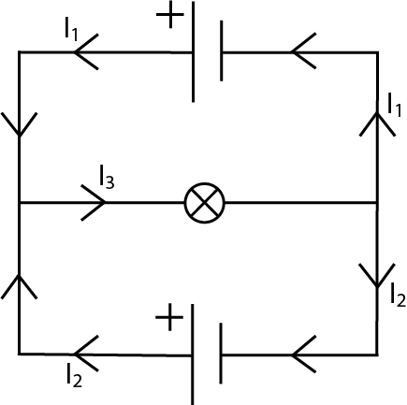
Let’s look at an example circuit with multiple batteries.
Things worth noting:
Both batteries have current travelling away from the positive terminal and returning to the negative terminal
The amount of current leaving a battery is the same amount returning to that battery. For example, the uppermost battery has a current of I₁​ leaving the positive terminal, and the amount of current returning to the negative terminal is also I₁​.
Kirchhoff’s current law applies to both junctions in this circuit. Looking at the left-most junction, I₁​ and I_{2​} are coming in, and I₃​ is coming out. Therefore, I₁​+I_{2​}=I₃​.

Slide 15
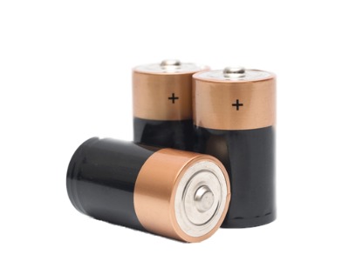
Sometimes, the circuit diagrams provided won’t have arrows to show the direction of current flow.
When faced with this situation, it is a good idea to go around the circuit and draw in the arrows yourself!
When doing this, it is important to remember our rule about current flow from batteries: conventional current will flow away from the positive terminal, and towards the negative terminal.

Slide 16
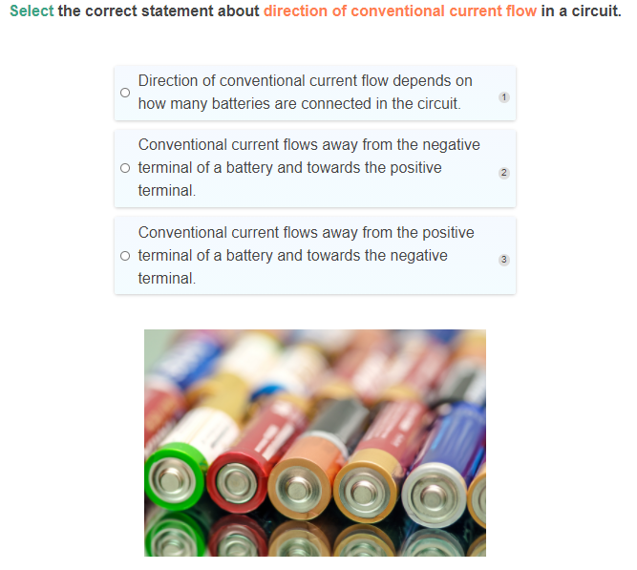

Slide 17
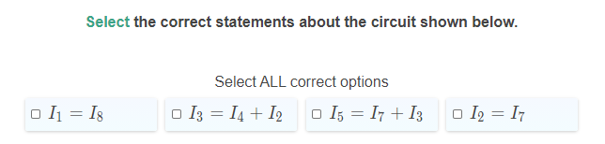
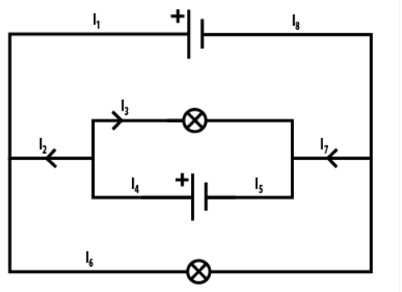

Slide 18
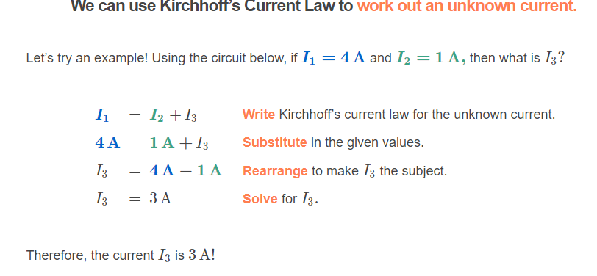
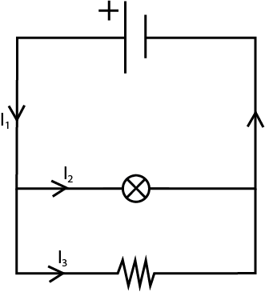

Slide 19
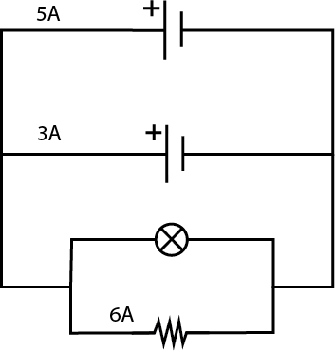
Let’s try a more complex example!
When approaching similar questions with more complex circuits, we can follow similar steps as the previous slide to find an unknown current:
Draw arrows representing the direction of current flow.
Choose a junction that involves the unknown current of interest.
Write an expression of Kirchhoff’s current law for that junction.
If another unknown current is involved in this junction, then repeat steps 2 and 3 at a different junction in order to have an equation for each unknown current.
Rearrange the equations if necessary, and solve for the unknown currents.
Let’s have a go! Given the circuit provided, what is the current travelling through the lamp?

Slide 20
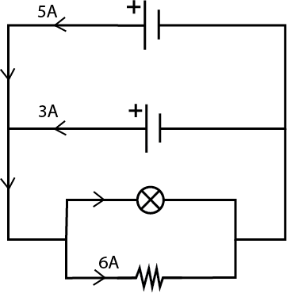
Step one is to draw arrows to represent the direction of current flow.
Recall that conventional current will always travel from the positive terminal to the negative terminal of a battery.

Slide 21
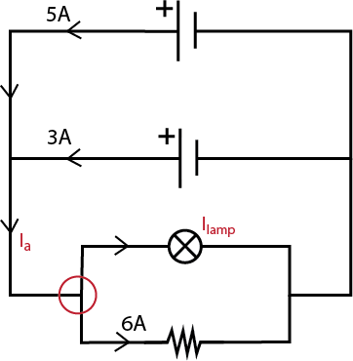
Step two is to choose a junction involving the unknown current of interest.
It also pays to label all unknown currents in this step to help you keep track of what you’re trying to work out!
Note that in this example, we have chosen the junction to the left of the lamp. We could’ve also chosen the junction to the right of the lamp, and we would get the same end result.

Slide 22
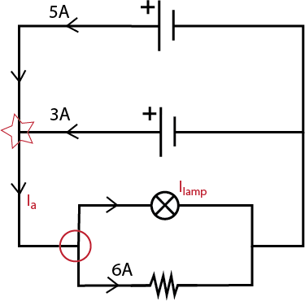
Step three is to write an expression of Kirchhoff’s current law for your chosen junction.
Following Kirchhoff’s current law, the equation for this circled junction can be written as I_{a}​=I_{lamp​}+6A.
Because this equation also contains another unknown current— I_{a}​—we must write another equation using a different junction to allow us to calculate I_{a}​. This junction has been indicated with a star, and the equation for this junction can be written as 5A+3A=I_{a}​.

Slide 23
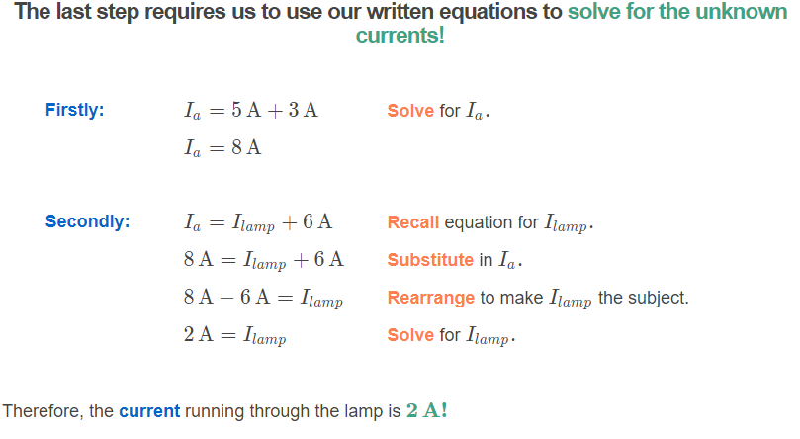

Slide 24
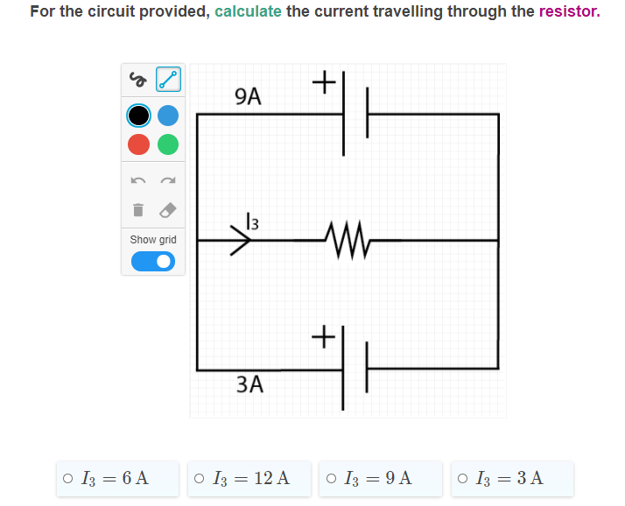

Slide 25
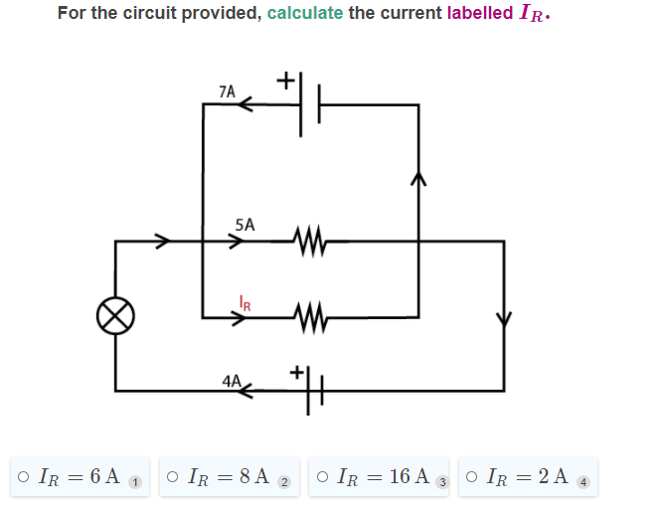

Slide 26
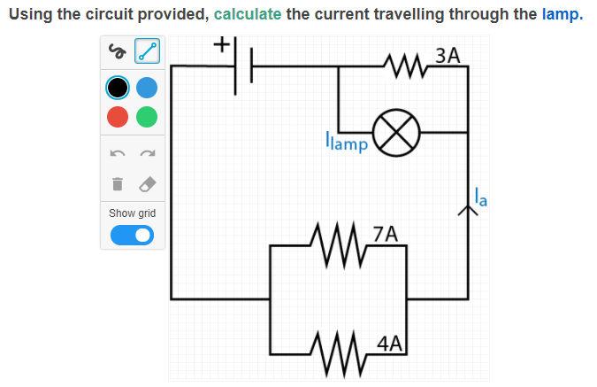
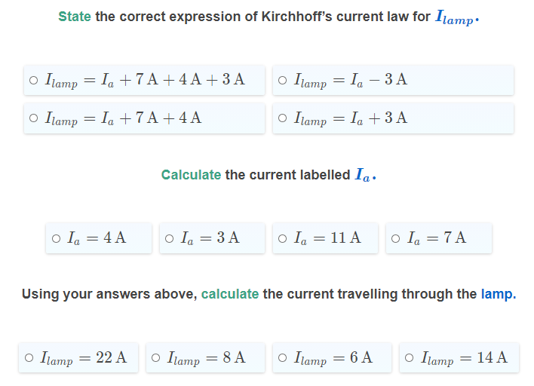

Slide 27
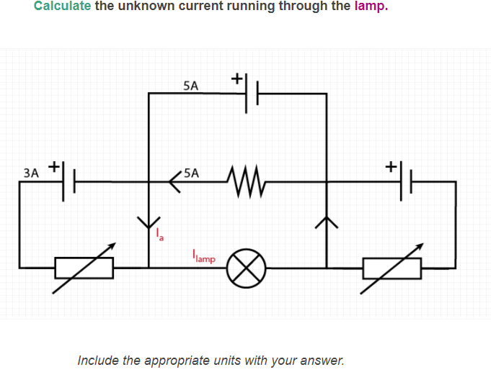

Slide 28
